Slide 1

SOHL’s Strat Plan Update
A new battleplan

Slide 2
This is what we are going to do today
During the pandemic many of us feel the need to take a second look at where we are and where our organizations are heading.
In our workshop we are going to deal with your Strategic Plan
(a new battle plan). You will be asked two questions.
What is working for SOHL today?
and what is not working?

Slide 3
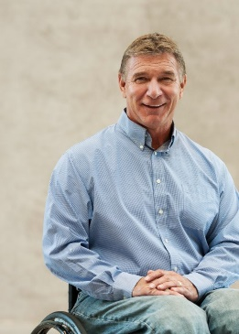
Rick Hansen – Man in Motion Tour
Let’s borrow from Rick Hansen – the Man in Motion Tour- Rick has a strategy of how to cope with seemingly tough events. https://www.rickhansen.com/. As a result of a severe spinal cord injury Rick faced some tough decisions in his life. Yet he want on to complete a world tour using only his wheel chair. Then he went on to develop a worldwide organization helping persons with disabilities,

Slide 4
SOHL’s Reality today
SOHL is facing some challenges today also. Let’s see what we can learn from Rick as he outlines the following stages he went through to get on top after a huge personal tragedy- becoming a paraplegic.
.

Slide 5
Here is what Rick Hansen says
First Rick tells us its okay to say “boy have I been handed a stinking pile of you know what”. After admitting the shock, he started to reframe, coming to grips with our/his new state.
Board thought: What is SOHL’s new state?
When we look at our new state, we start asking what information do I need to gather, what research do I need to do and what knowledge do I hope to gather about my possibilities?
Board thought: What new information has SOHL gathered and what does it need to learn more about?
Now Rick says we look to see what is within my control and what is not.
Board thought: What is within SOHL’s power to change?

Slide 6
More from Rick
Next what processes do I need to instigate?
Board thought: What new processes does SOHL need to undertake during C-19.
Then how can I turn loss into opportunity? All the while admitting we are in a tough spot.
Board thought: What are SOHL’s new opportunities?
Finally, he advises we create a Battleplan for each day, if so minute by minute. All this done believing we are creating a better world for ourselves. The Core element he shares is if we know the why we exist we can figure out the how.
Board thought: What is SOHL ‘s? Why, and how do we make that happen?

Slide 7
The above questions will inform your answers to our two main directional questions. Now we will ask you to share with us the following:
what is working for SOHL today?
and what is not working? (From here we will develop key actions for the areas not working -the battleplan, we are looking for up to 4 challenges we are facing)

Slide 8
What’s not working these are our Challenge areas
Let’s reframe the four challenge elements into outcome statement for example- our classrooms are not functioning an outcome statement could be- SOHL has become an innovator in virtual language instruction key actions how do we do it and who helps us, where, when see model below
Logic Model
Key actions to implement change These actions will stimulate the change we want to see | Who do we partner with, where do we do this and when? 4 areas | Outcome statement (The change we want to see in our challenge area) 4 areas Example: SOHL is an innovator in virtual language instruction | The Overall state we want to achieve SOHL is the catalyst to sustaining language and cultural benefits for all Saskatchewan residents

Slide 9

Final Exercise
You will now create an elevator pitch with all your workshop partners. We call this the 25-word workplan -the elevator pitch.
Remember we are going to use this pitch with everyone we meet when asked what SOHL is doing during the Pandemic.

